Slide 1







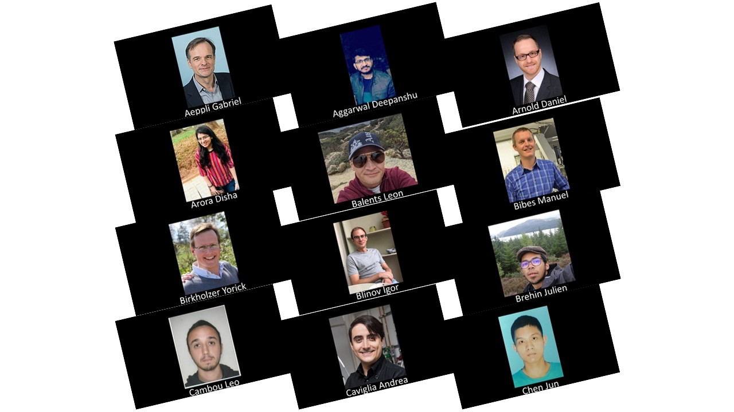
EMERGENT ELECTRONIC STATES CONFINED AT INTERFACES
Session CXV
July 6- 24, 2020
Committee members:
Marc Gabay (Université Paris-Sud, Paris-Saclay, France)
Masashi Kawasaki (The University of Tokyo, Japan)
Andrew Millis (Columbia University and The Flatiron Institute, USA)
Jean-Marc Triscone (Université de Genève, CH)
Ralph Claessen (Julius-Maximilians University, Germany) (Advisory)
Jochen Mannhart (MPI Stuttgart, Germany) (Advisory)
Website: https://physiquedeshouches2020.wordpress.com/
Les Houches Center: https://www.houches-school-physics.com

Slide 2
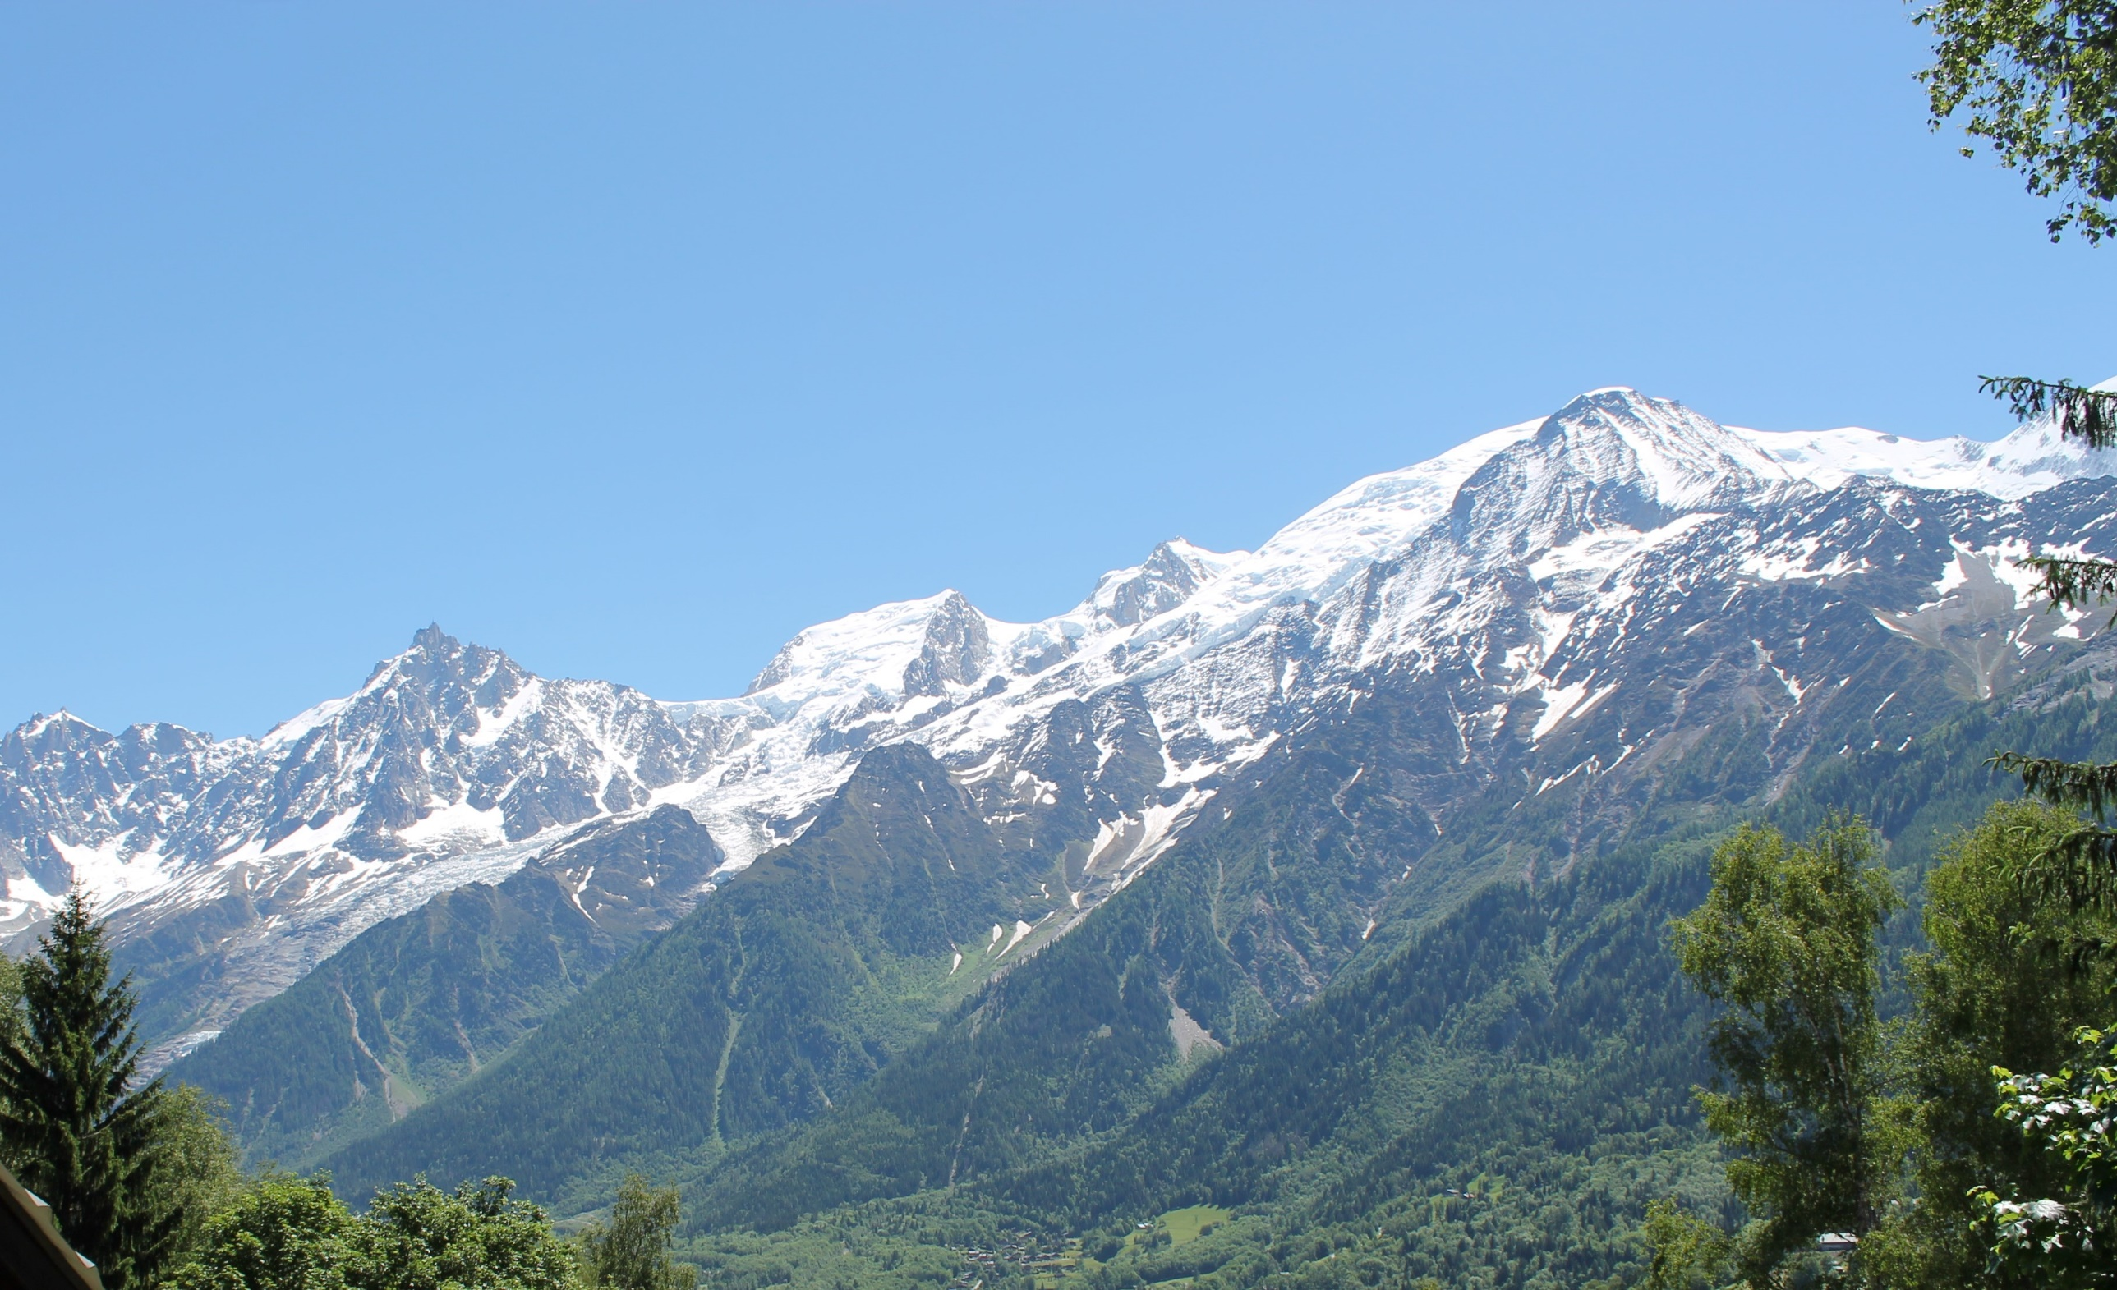
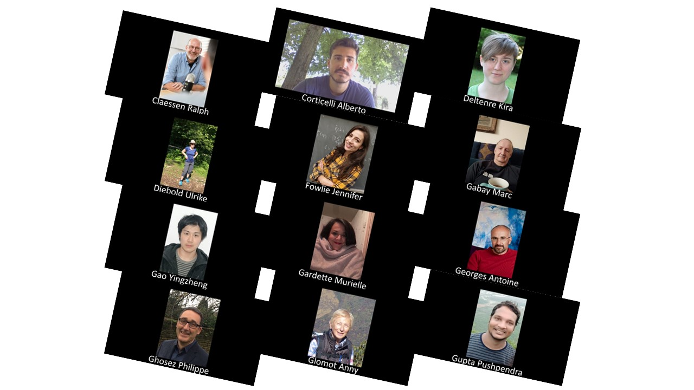

Slide 3
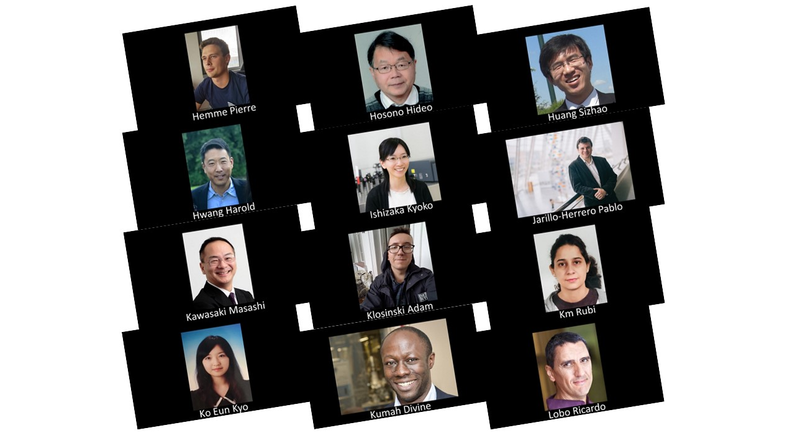

Slide 4
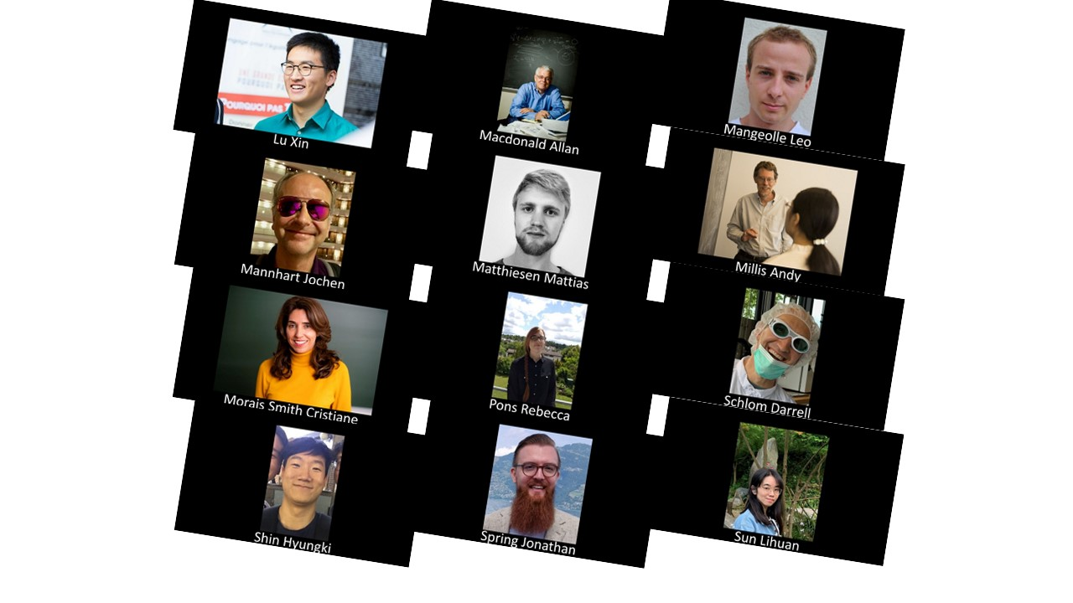

Slide 5
